Slide 1
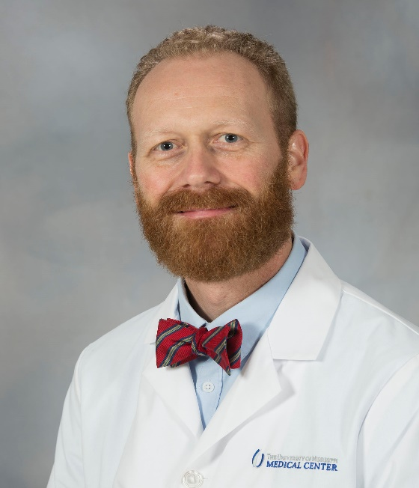
Presenter
Daniel C. Williams, PhD
Licensed clinical psychologist
Associate Professor, Director of Psychology, Department of Psychiatry and Human Behavior, SOM
Associate Director, Office of Well-being
Completed PhD at the University of Memphis, residency at the VA North Texas Health Care System
Dwilliams10@umc.edu

Slide 2
SELF-CARE DURING COVID-19
Prioritize sleep
Create structure and a routine
Make time for valued activities
Breathe
Move your body and find ways to exercise
Stay socially and emotionally connected

