Slide 1
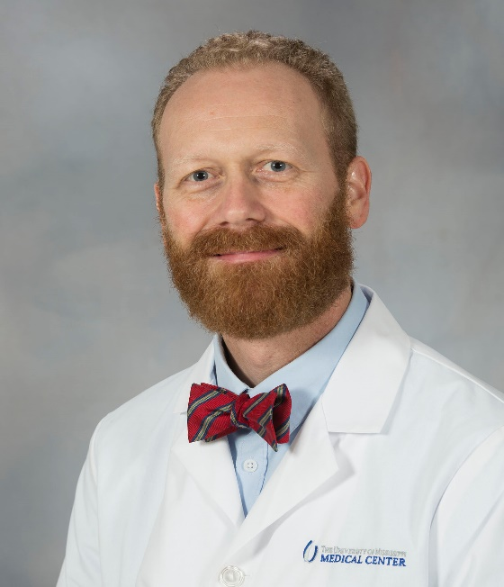
Presenter
Daniel C. Williams, PhD
Licensed clinical psychologist
Associate Professor, Director of Psychology, Department of Psychiatry and Human Behavior, SOM
Associate Director, Office of Well-being
Completed PhD at the University of Memphis, residency at the VA North Texas Health Care System
Dwilliams10@umc.edu

Slide 2
Coping with COVID-19
Accept that life is going to be different for a while.
Focus on what you can control & facts.
Limit exposure to news and social media.
Find the silver lining.
5. Talk about what’s going on.

